Slide 1

Tiled-Based Forward Rendering
Li Hongbo
Graphics Engineer

Slide 2

Agenda
Reasons to use Tiled-Based Forward
Basic Tiled-Based Forward technology
Light Culling Improvements
Compare with TBDR

Slide 3
Reasons to use Tiled-Based Forward
Compared with forward, it supports large-scale light sources
Supports hardware MSAA compared to deferred rendering
Better support for transparent materials than deferred rendering
Less bandwidth consumption than deferred rendering

Slide 4
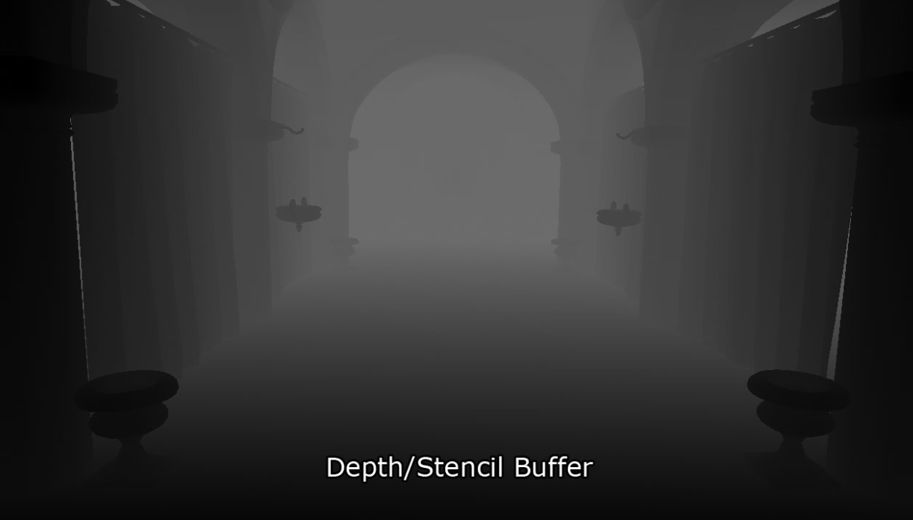
Tiled-Based Forward
Pre Z Pass

Slide 5
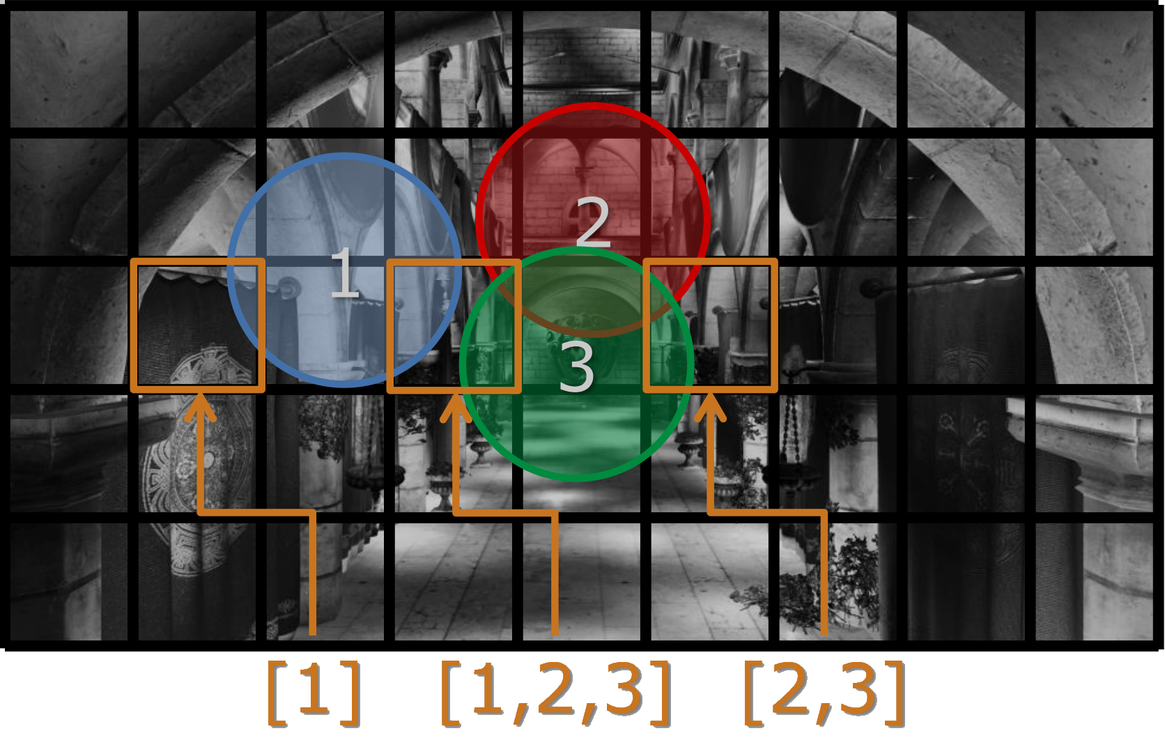
Tiled-Based Forward

Slide 6
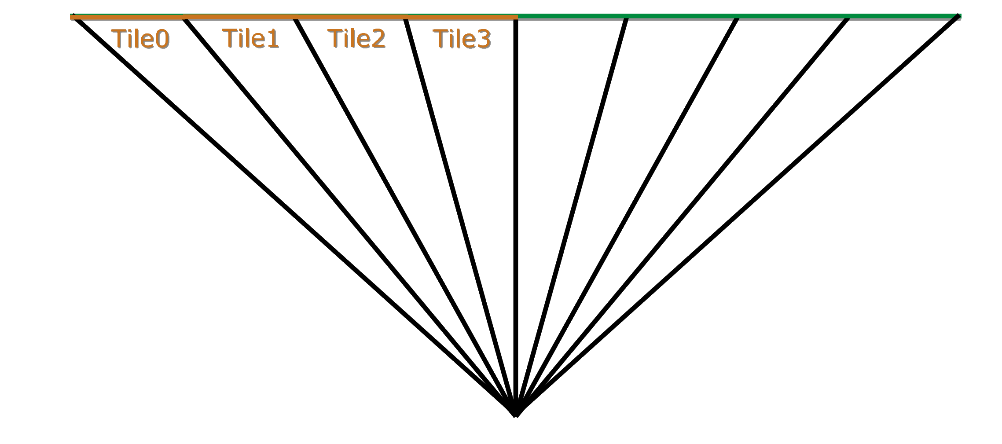
Tiled-Based Forward
Divide screen into tiles
Fit frustum around each tile

Slide 7
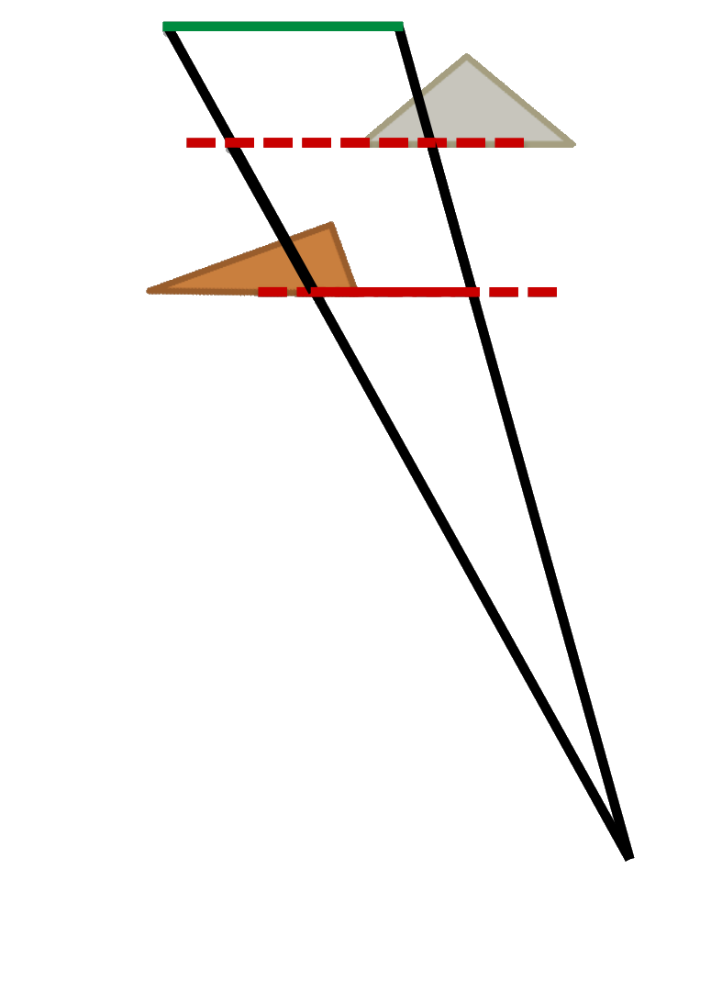
Tiled-Based Forward
Use z buffer from depth pre-pass as input
Find min and max depth per tile
Use this frustum for intersection testing

Slide 8
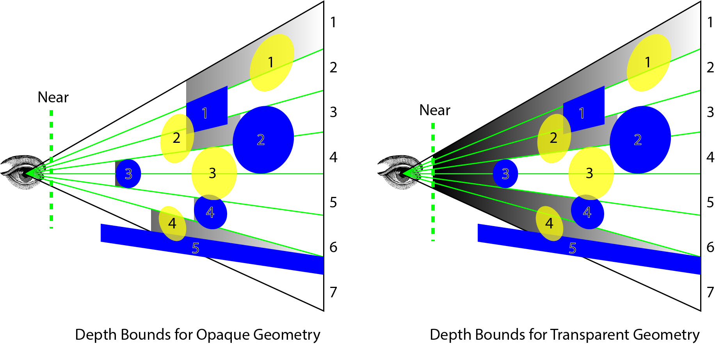
Tiled-Based Forward

Slide 9
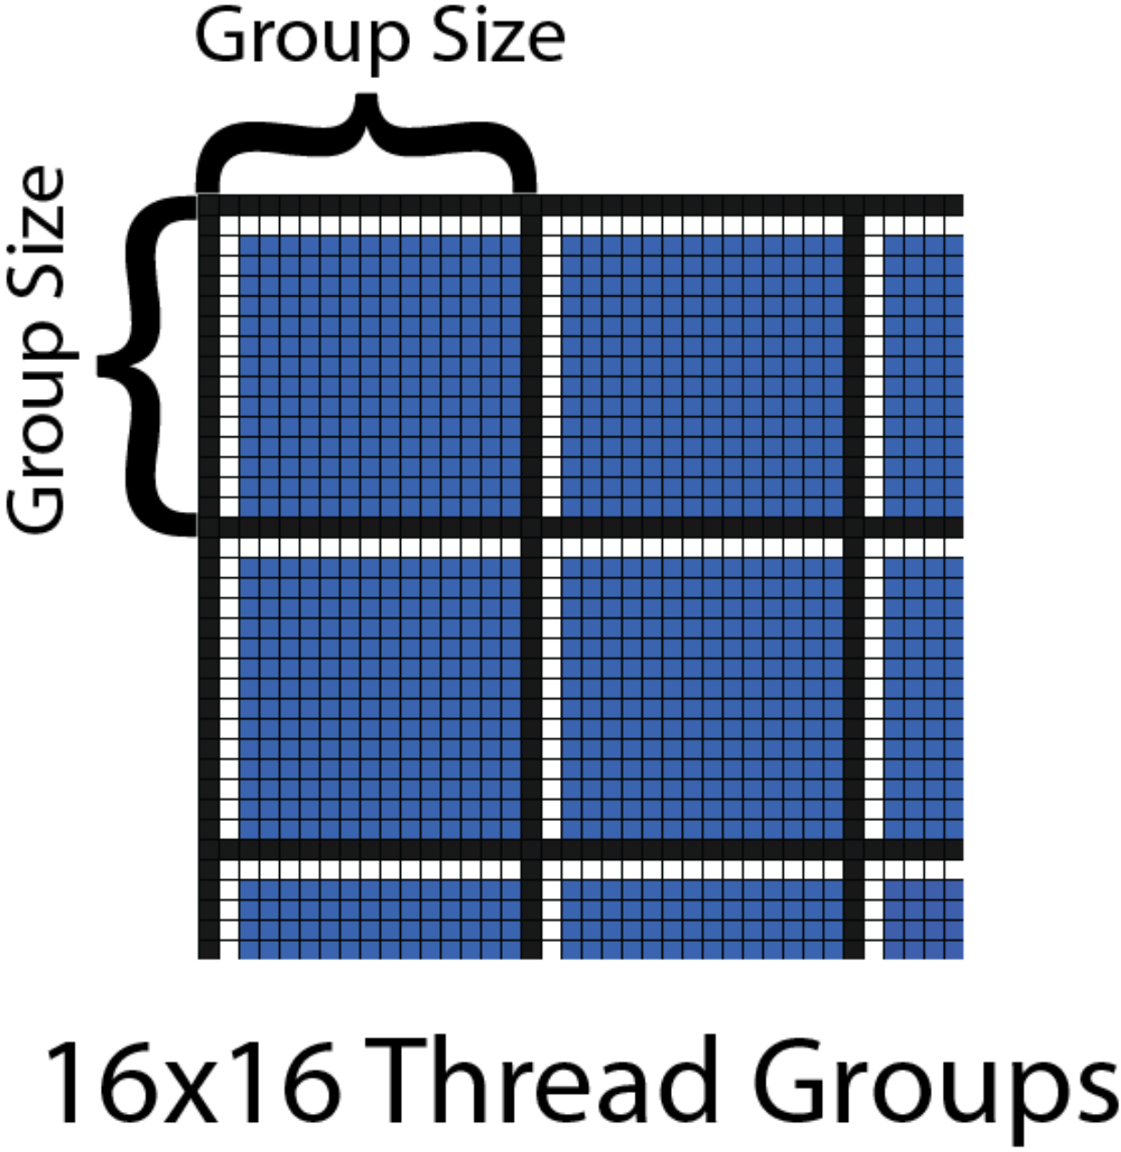
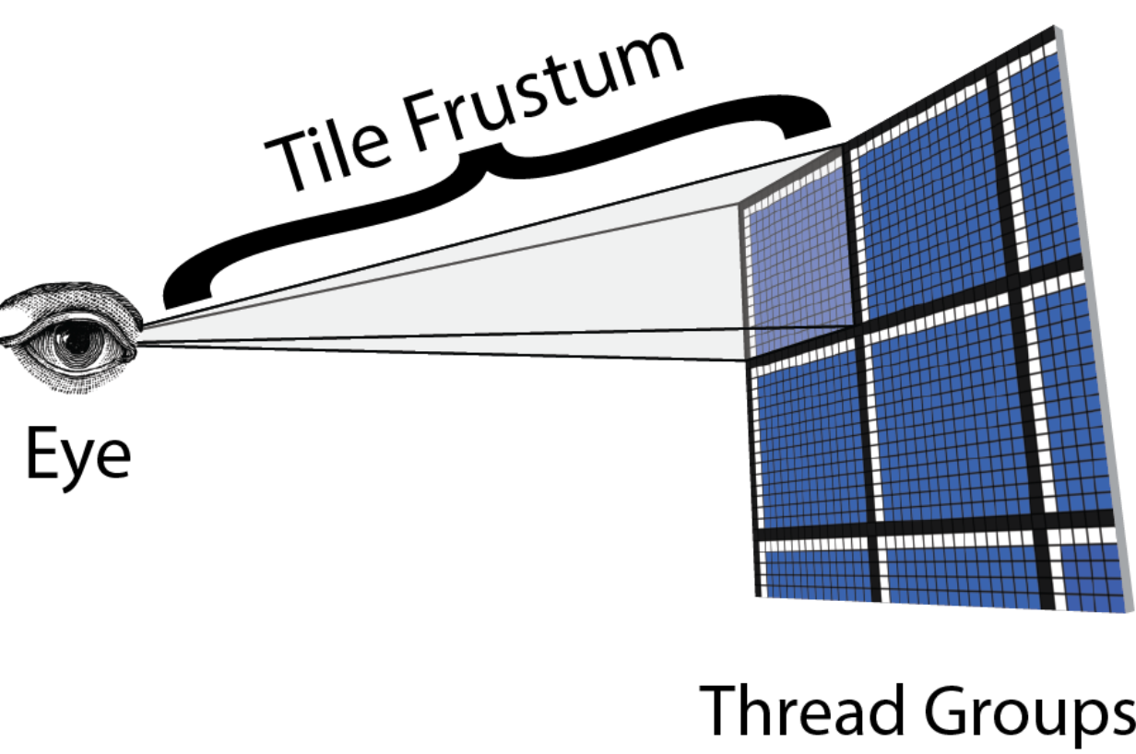
Tiled-Based Forward
Filled tiles use asynchronous compute shaders
The dispatch thread size is preferably a multiple of the minimum dispatching thread of the graphics card.
(NVIDIA:32 AMD:64)

Slide 10
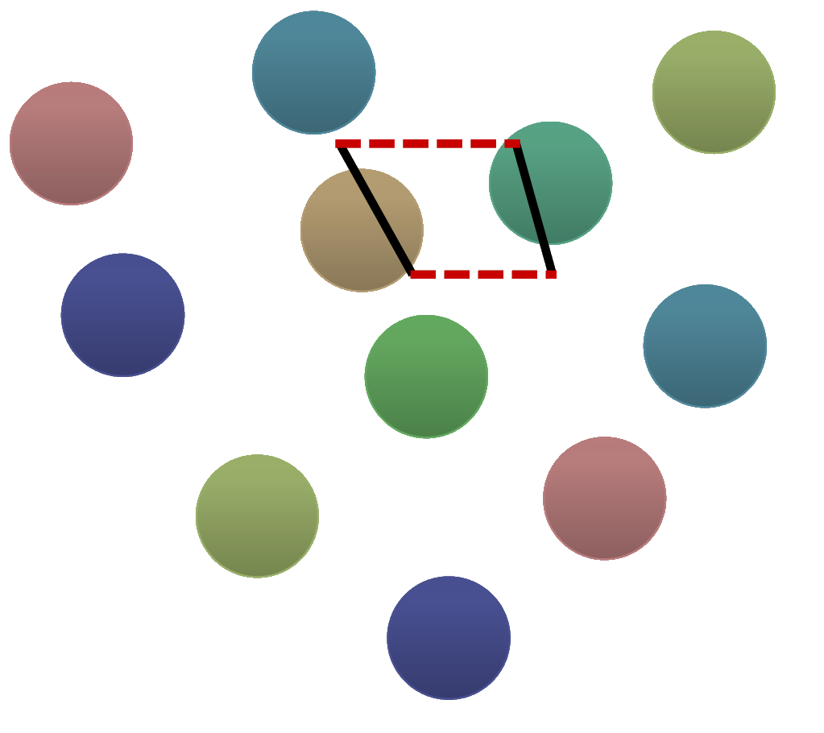
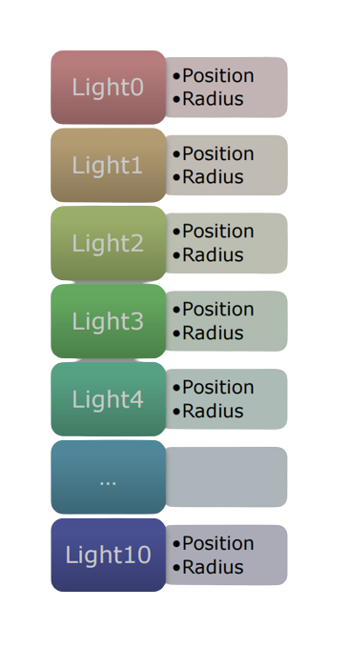
Tiled-Based Forward

Slide 11
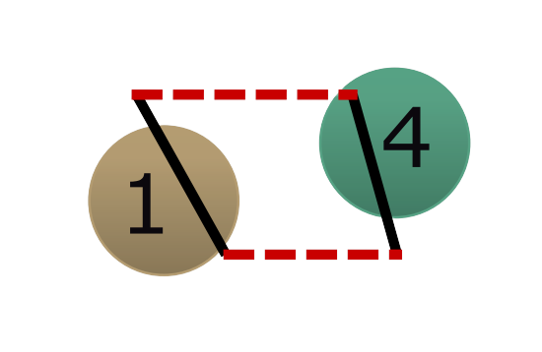
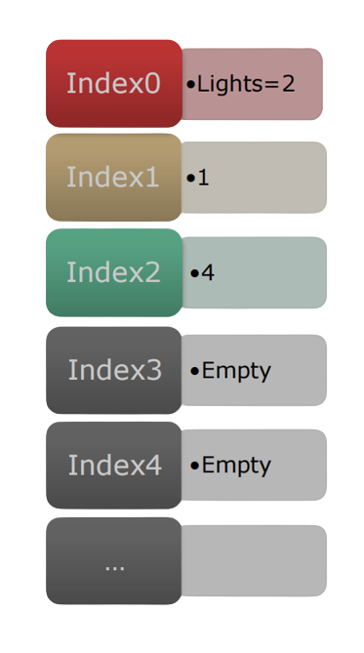
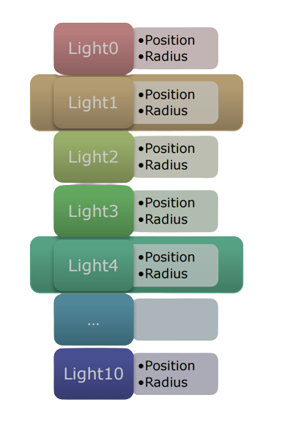
Tiled-Based Forward

Slide 12
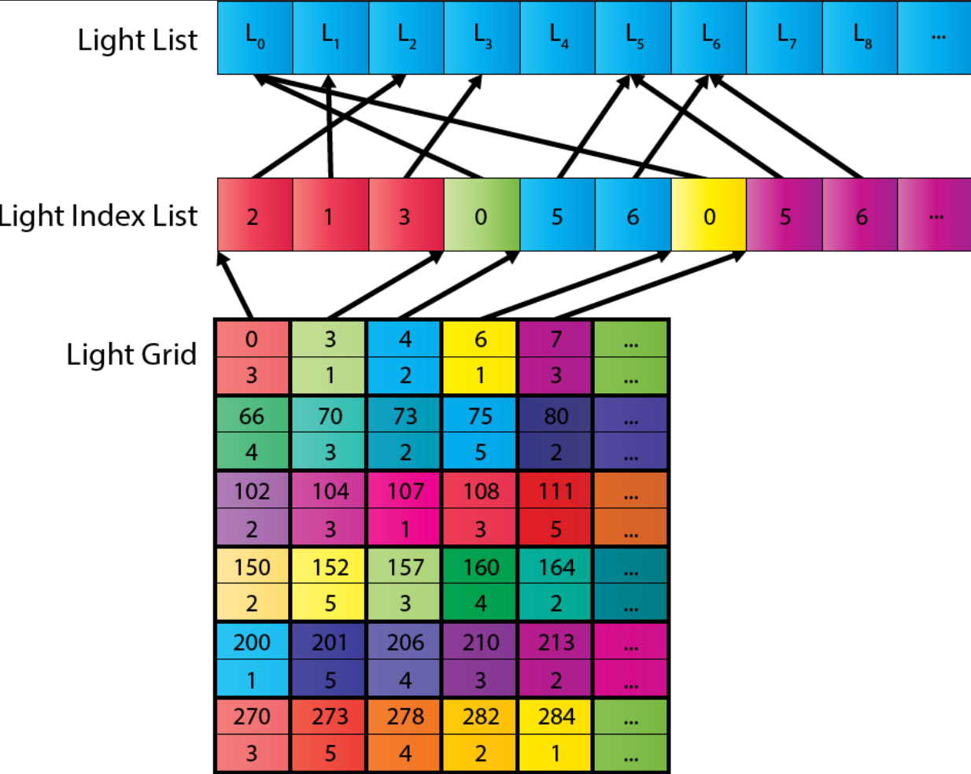
Tiled-Based Forward

Slide 13
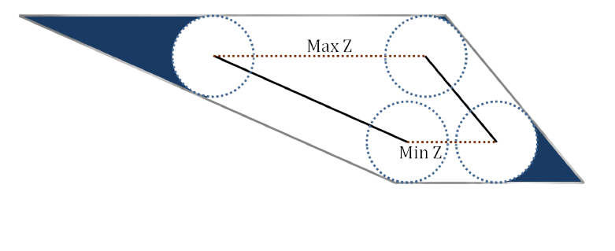
Sphere-Frustum Test

Slide 14
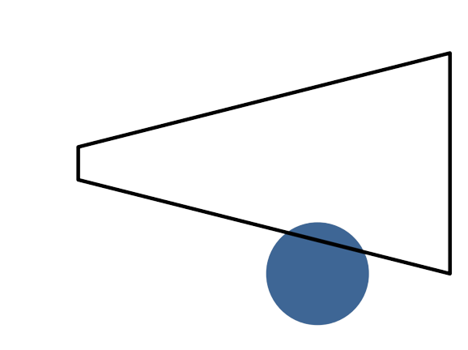
Sphere-Frustum Test

Slide 15
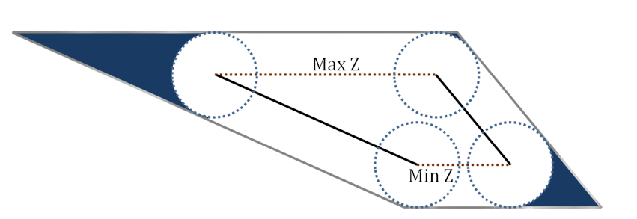
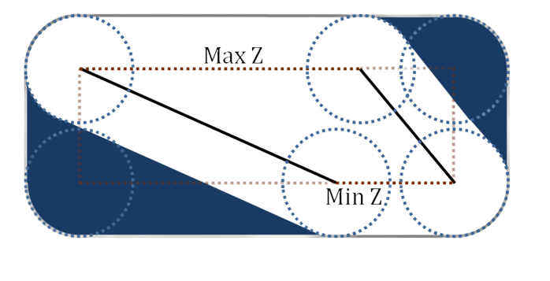
Frustum planes
AABB around Frustum

Slide 16
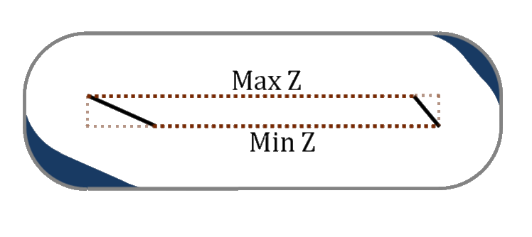
AABB around long frustum
AABB around short frustum

Slide 17

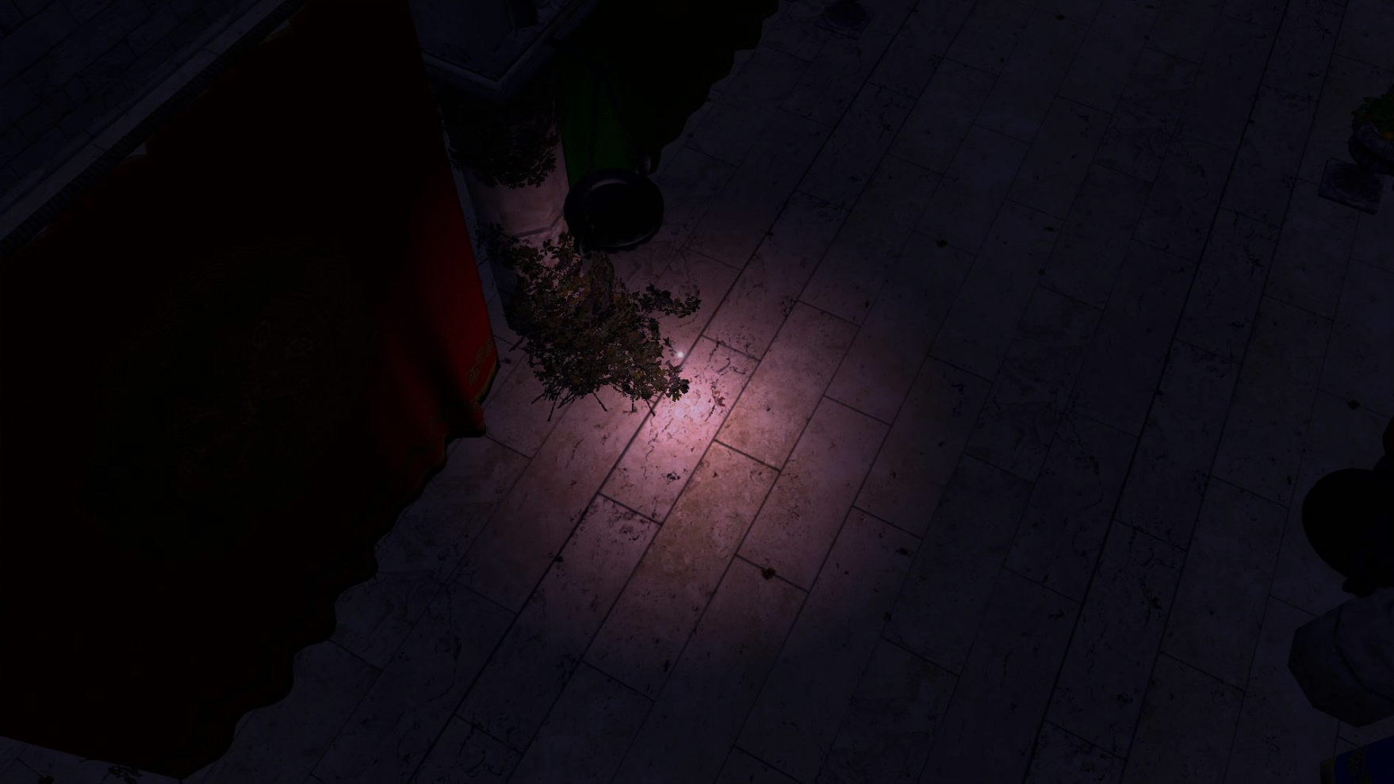

AABB/Sphere Test
Single Point Light
Frustum/Sphere Test

Slide 18
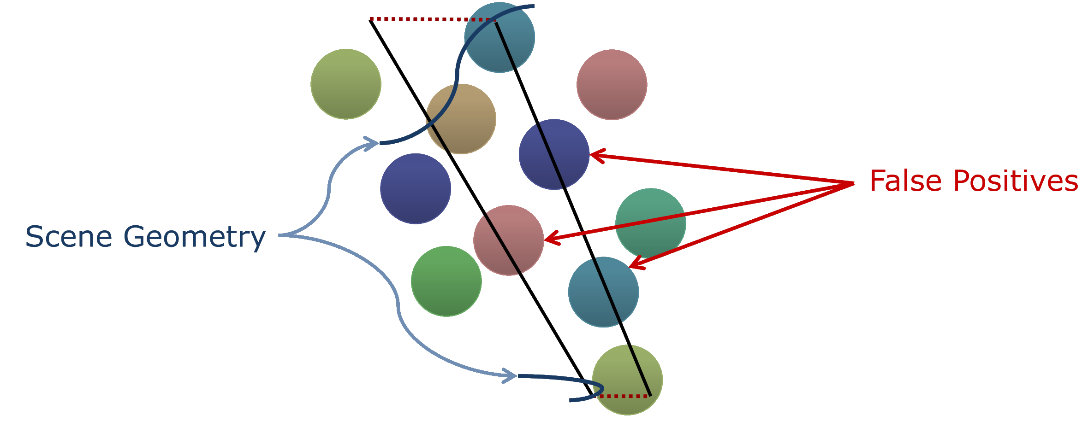
Depth Discontinuities

Slide 19
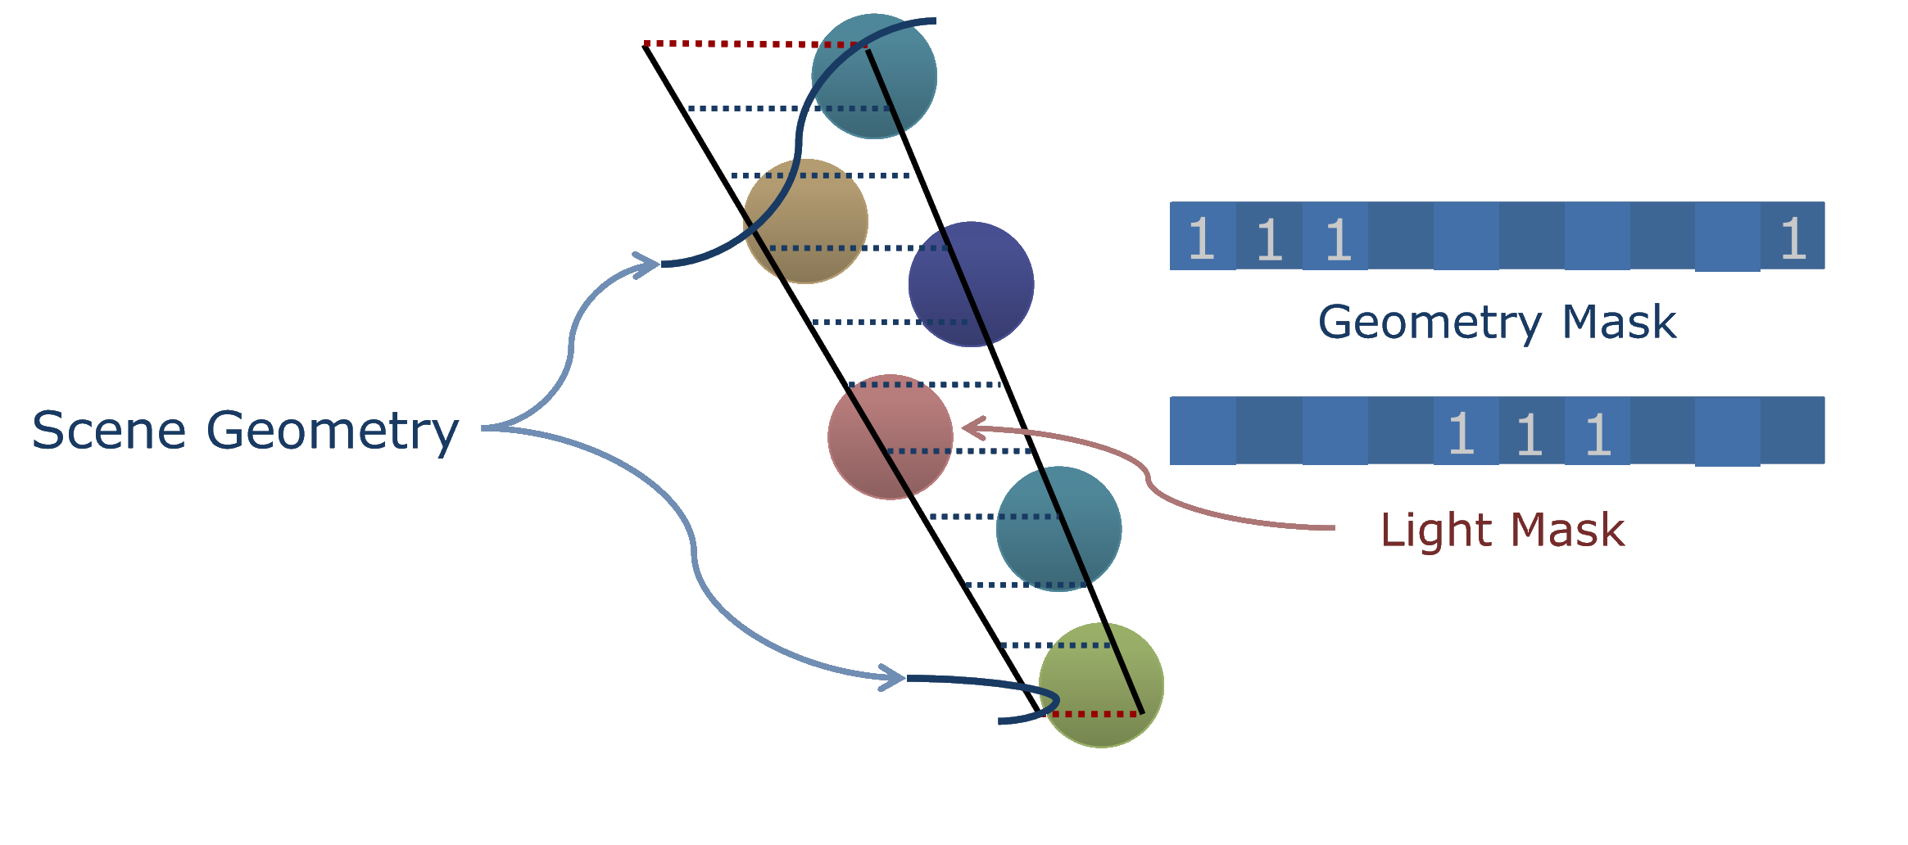
2.5D Culling

Slide 20
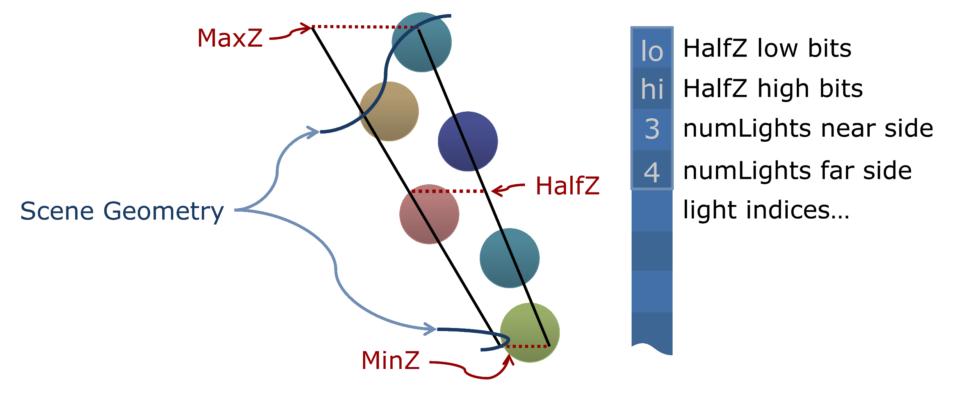
HalfZ

Slide 21
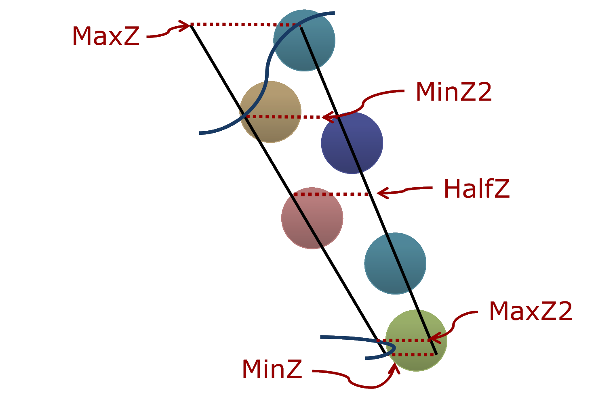
Modified HalfZ

Slide 22
Tile Size
GPU:3080 , Light Size: 50 ,1440p ,1024 Lights
Tile Size | Culling Time | Color Pass Time | Total
8x8 | 2.831 ms | 4.291 ms | 7.122 ms
16x16 | 0.688 ms | 4.407 ms | 5.095 ms
32x32 | 0.189 ms | 4.331 ms | 4.52 ms
GPU:3080 , Light Size: 10 ,1440p ,1024 Lights
Tile Size | Culling Time | Color Pass Time | Total
8x8 | 2.913 ms | 4.231 ms | 7.144 ms
16x16 | 0.685 ms | 4.184 ms | 4.869 ms
32x32 | 0.187 ms | 4.245 ms | 4.432 ms

Slide 23
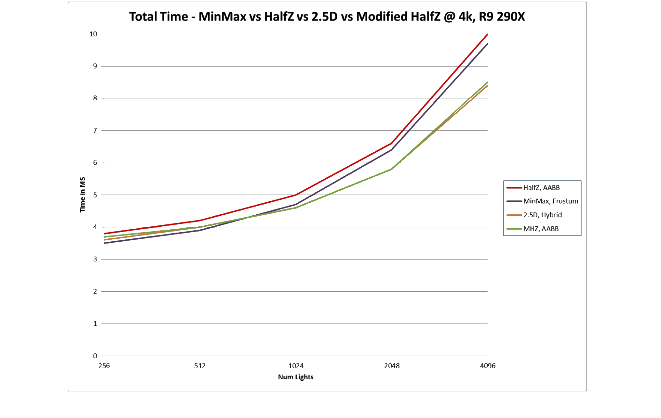
AMD light culling performance graph reference

Slide 24
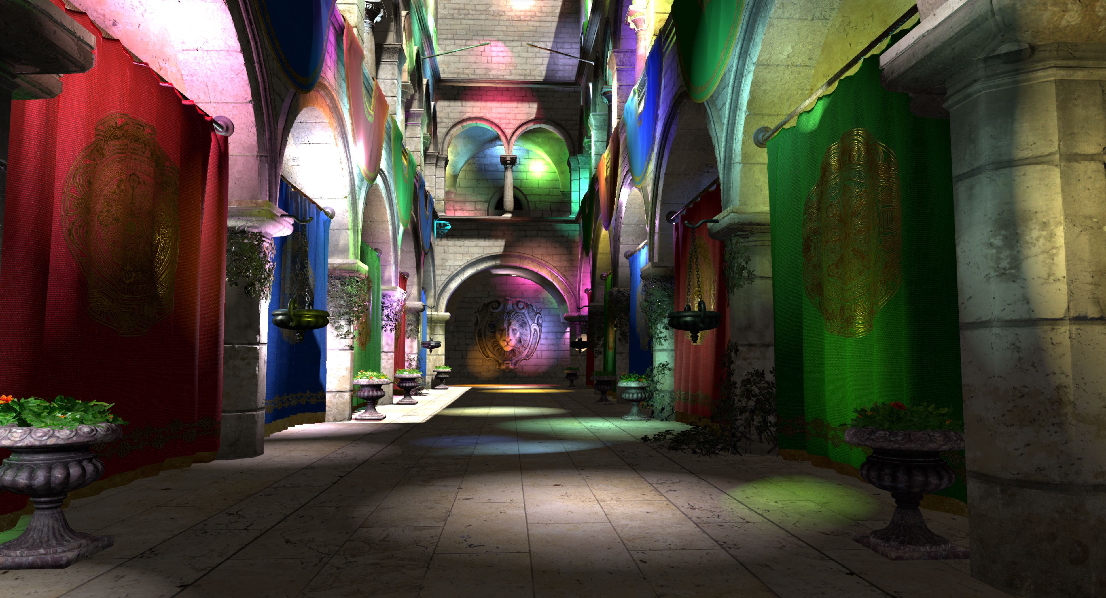
Demo

Slide 25
Compare with TBDR
Tiled-Based Forward
Advantages:
Better support for MSAA and transparent materials than TBDR
low bandwidth consumption
Support for large-scale light sources
Unlimited number of supported materials
Disadvantages:
Not friendly to various post-processing algorithms that require GBuffer data such as normals
Small triangles can cause over shading
Tiled-Based Deferred
Advantages:
Friendly to various post-processing algorithms that require GBuffer data such as normals
Support for large-scale light sources
Disadvantages:
High bandwidth consumption and high video memory consumption
The number of supported materials is limited
Unfriendly support for MSAA and transparent materials

Slide 26
References
Gareth Thomas: Advancements in Tiled-Based Compute Rendering, AMD,GDC2015
Andrew Lauritzen Advanced Rendering Technology (ART) Intel Corporation: Deferred Rendering for Current and Future Rendering Pipelines ,ACM SIGGRAPH 2010
Ronan Marchalot: Clustered Forward Renderingand Anti-Aliasing in‘Detroit: Become Human’,GDC2018
Takahiro Harada, Jay McKee, and Jason C.Yang: Forward+: Bringing Deferred Lighting to the Next Level
Ola Olsson, Markus Billeter, and Ulf Assarsson :Clustered Deferred and Forward Shading
Forward vs Deferred vs Forward+ Rendering with DirectX 11
GPU-based Forward+ renderer
Forward+ renderer in Vulkan using Compute Shader

Slide 27
Thank you!

